Slide 1

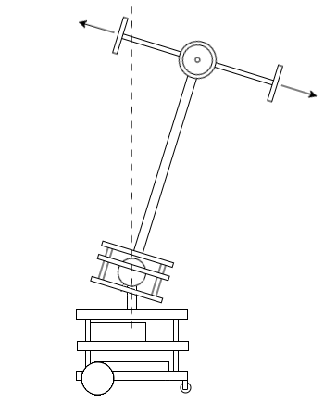
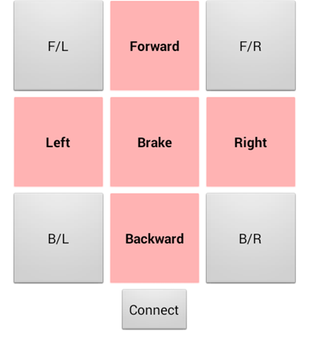
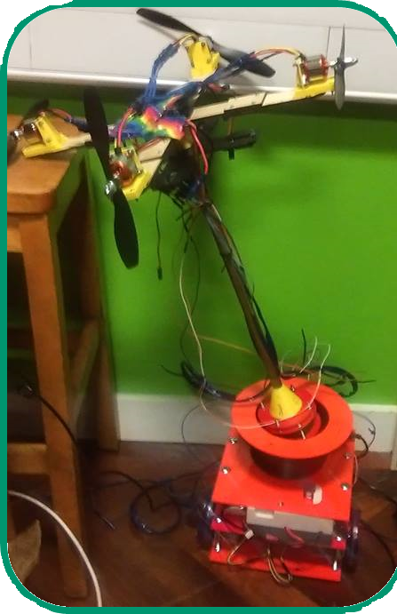
Construction and Control of a 3DOF Inverted Pendulum with Propellers and a Ground Robot
Charlie Bell
Department of Electrical and Electronic Engineering, South Kensington Campus, Imperial College London.
1 - Introduction
This project focuses on the design and implementation of different controllers for the Quadrotor Top Inverted Pendulum (QTIP) robot constructed in [1]. The project aims to demonstrate the efficacy of H∞ control applied to real systems compared to PID.
4 - Modelling
Three different model dynamics were derived for the ball joint; these are for each DOF of the ball joint. At 1 DOF the dynamics equations are near identical to that of an inverted pendulum. At 2 and 3 the dynamics become significantly more complex.
2 - Design
QTIP takes the basic mechanical structure of an inverted pendulum on a cart and expands it into three dimensions. Figure 1 presents a 2 dimensional diagram of the system.
5 – Sensing and filtering
The MPU6050 provided gyroscope and accelerometer readings in all degrees of freedom; the gyroscope giving sharper and more noisy readings, while the accelerometer gave smoother and slower readings. A complementary filter was used to fuse the data coming from the MPU6050 to give a smooth reading of angle.
Four Pololu infrared reflective distance sensors were calibrated to give additional angle measurements of the pendulum arm.
The pendulum arm rotates about a variable 1-3 degree of freedom (DOF) ball joint at its base. The ball joint is attached to the cart which is actuated by two brushless DC motors, with a third wheel castor wheel. All electronics are based in the cart chassis.
The pendulum arm is stabilised in the upright position by four propellers producing a lateral thrust.
6 - Interfacing
A basic mobile app was built to communicate with the Arduino Mega2560 board via Bluetooth (Figure 3). The HC-05 Bluetooth module was connected to the Arduino and acted as a transmitter/receiver.
Figure 1: QTIP concept
3 - Construction
The completely constructed QTIP is shown in Figure 2.
The propellers at the top of the pendulum arm are controlled by 30A ESCs. These propellers can be mounted at varying angles to allow for increased yaw controllability at the cost of decreased roll and pitch controllability. An MPU6050 gyroscope/accelerometer is mounted at the top of the pendulum arm in the central axis.
The power supply and controller are housed in the cart frame at the bottom.
Figure 3: User interface
7 - Control
Control was performed using a PID approach and a H∞ scheme. The advantages of each are displayed in Table 1.
Table 1: Controller advantages and disadvantages
PID – Advantages | H∞ – Advantages
Does not require model. Simple to program. | Robust to uncertainties. MIMO applicable. Stability analysis.
PID – Disadvantages | H∞ – Disadvantages
9 tuneable parameters. Difficult to apply to MIMO. Not robust. | Requires reasonable model.
Figure 2: QTIP robot
ACKNOWLEDGEMENTS
Dr Eric Kerrigan of the Faculty of Engineering, Department of Electrical and Electronic Engineering.
Ian McInerney of the Faculty of Engineering, Department of Electrical and Electronic Engineering.
REFERENCES
[1] Uhing, Paul Frederick. (2016). "Design, modeling, and control of a two degree of freedom pendulum on an omnidirectional robot.“ Graduate Theses and Dissertations. 15825.
[2] Grifo, Francisco. (2018). “Design and Construction of a Quadrotor Top Inverted Pendulum.”

